Slide 1
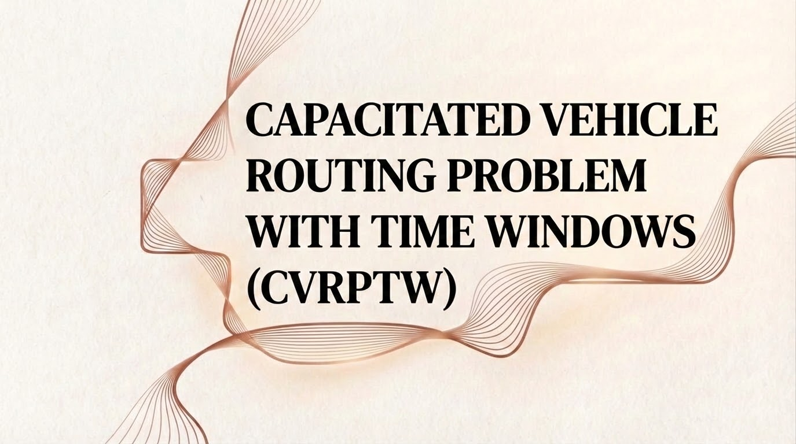

Slide 2
Formal Definition: CVRPTW
Objective: To find the optimal routes for a fleet of vehicles to serve a set of customers, minimizing the total distance traveled and the number of vehicles used.
Given Components
Customers (I): A set of n customers, I = {1, 2,..., n}.
Depot: A central depot (node 0) where all routes start and end (node n+1).
Vehicles (K): A fleet of k identical vehicles.
Key Properties & Constraints
For Each Customer i :
Location: (x_i, y_i)
Demand: q_i > 0
Service Time: s_i (duration to unload)
Time Window: [a_i, b_i] (Earliest and latest start time for service)
For Each Vehicle k:
Capacity: Q > 0
Travel Time: Ti,j (Euclidean distance from i to j customer)

Slide 3
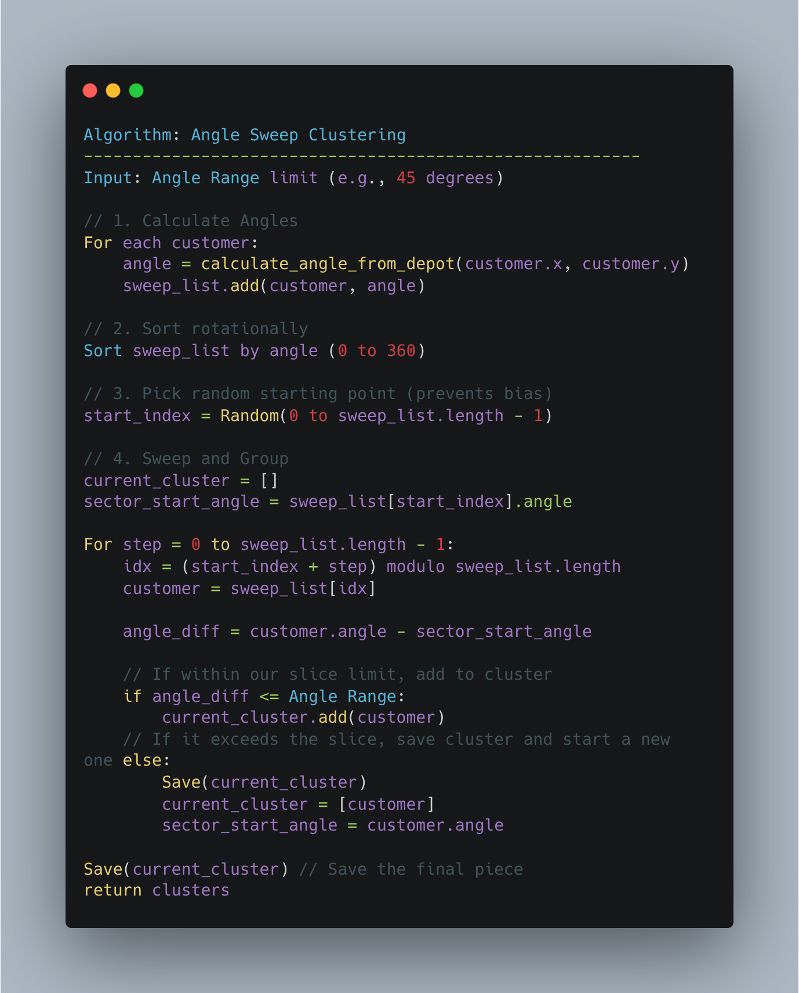
Clustering Algorithm

Slide 4
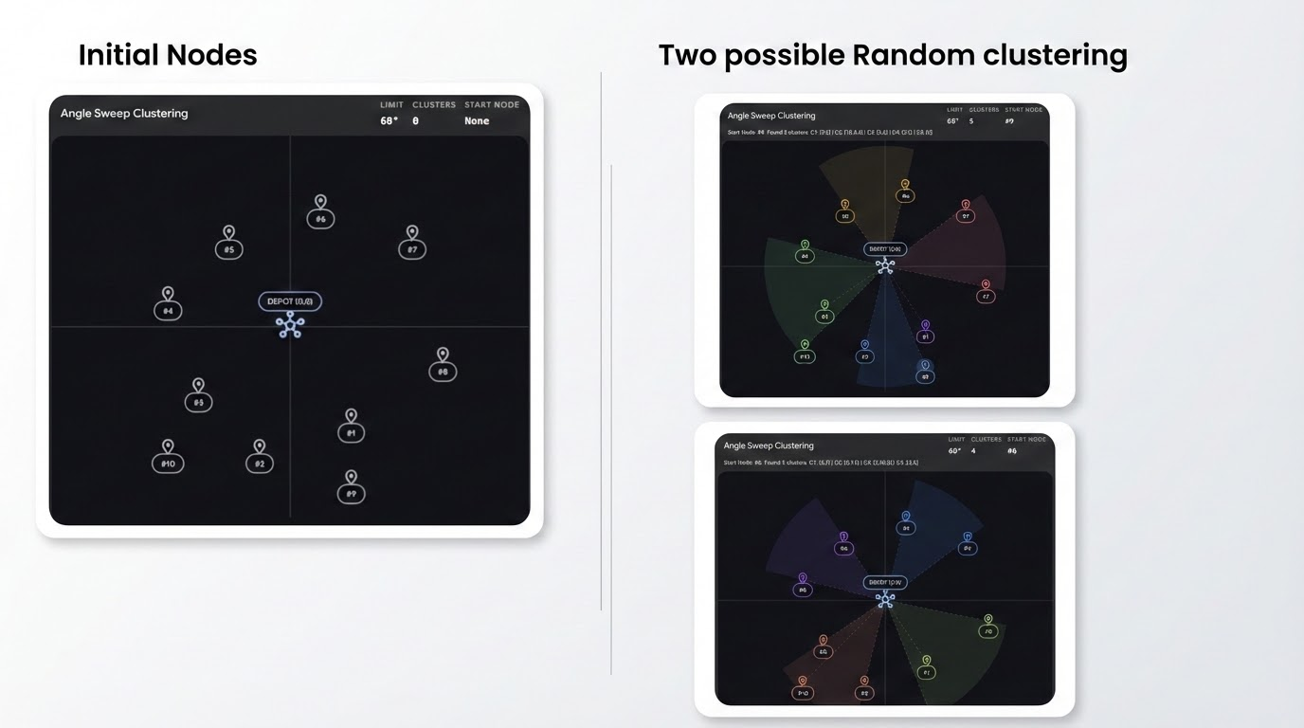

Slide 5
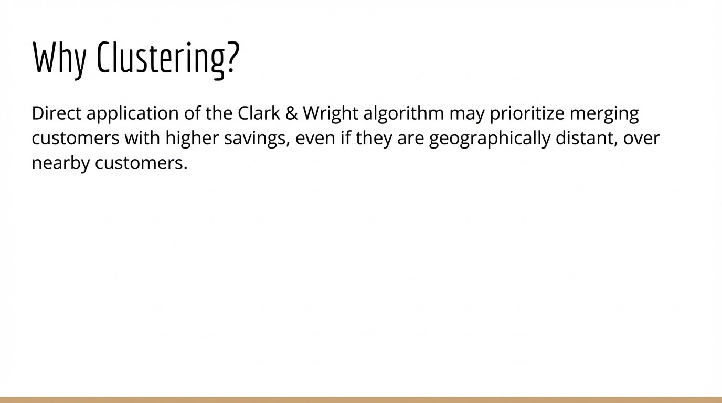

Slide 6
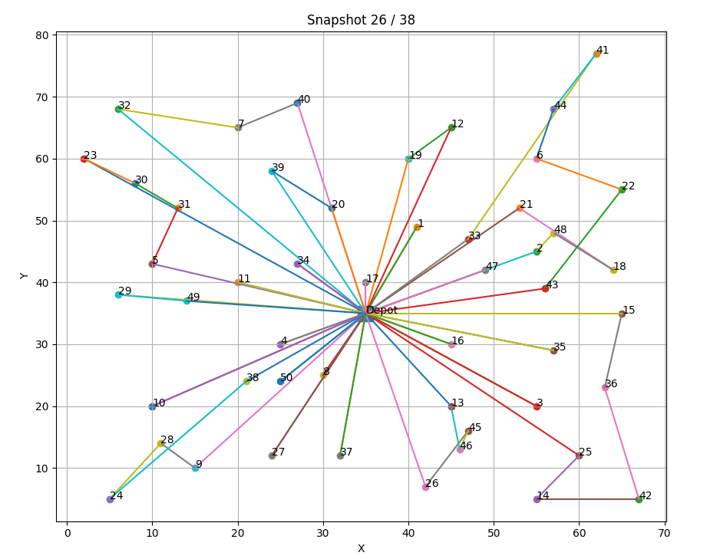

Slide 7
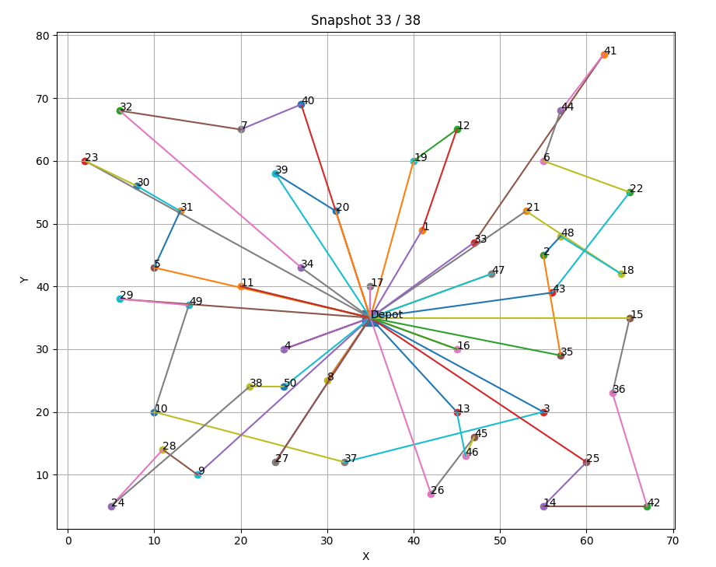

Slide 8
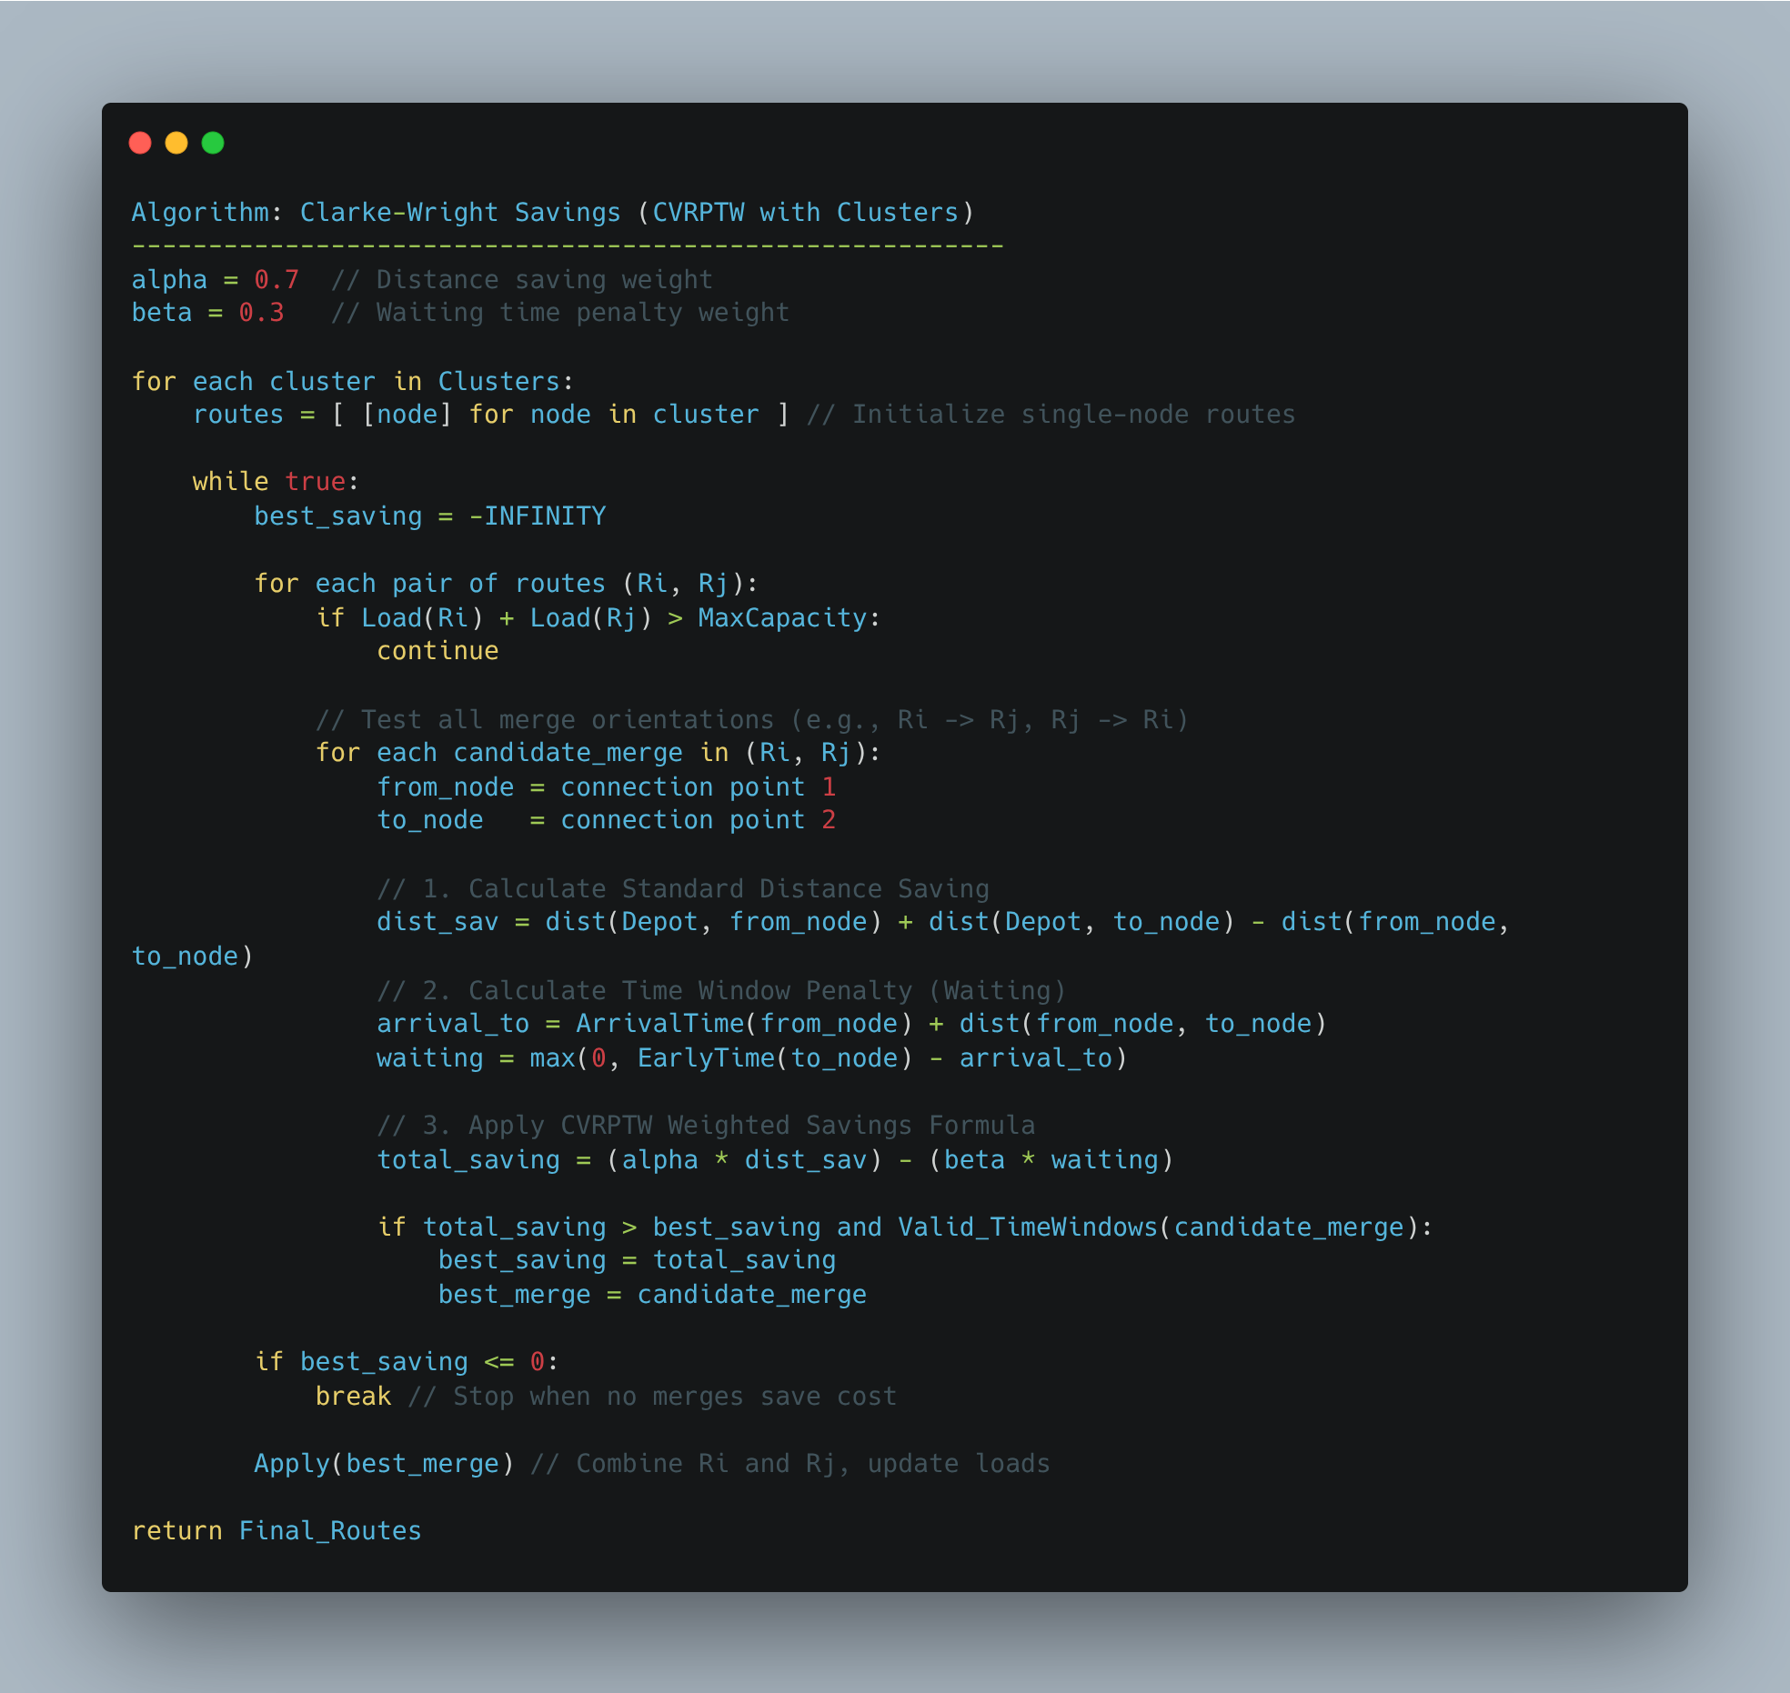
Route Construction (Clark & Wright)

Slide 9
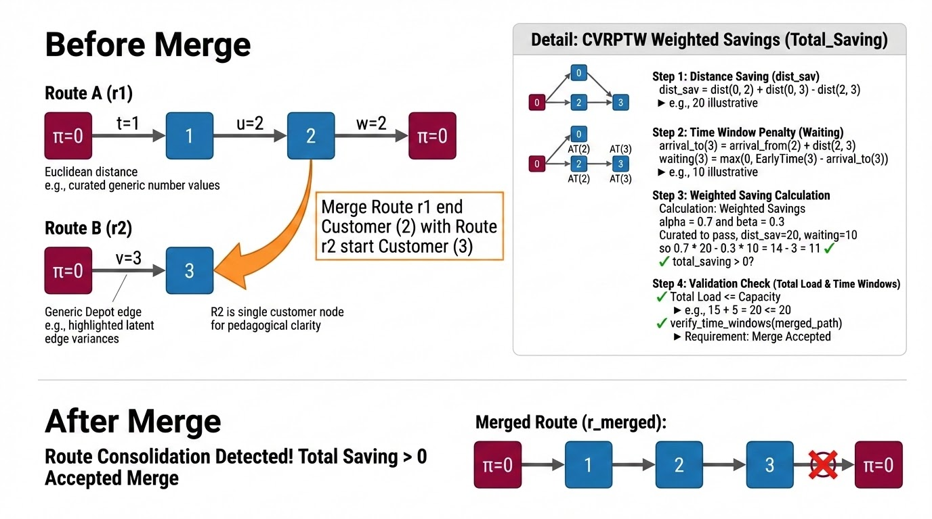

Slide 10
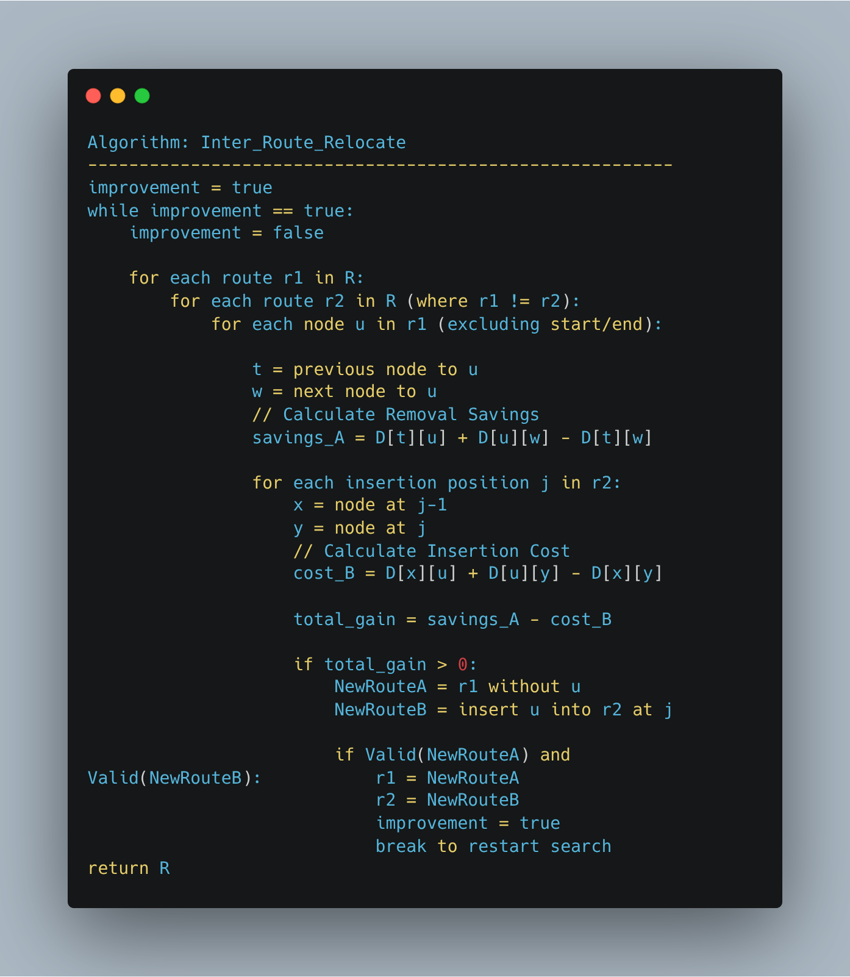
Inter Route Relocate Algorithm:

Slide 11
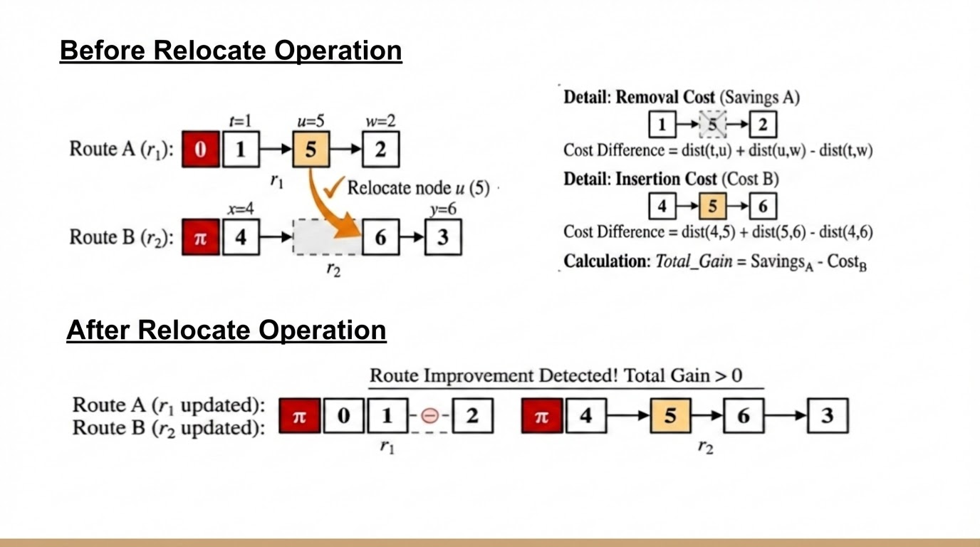

Slide 12
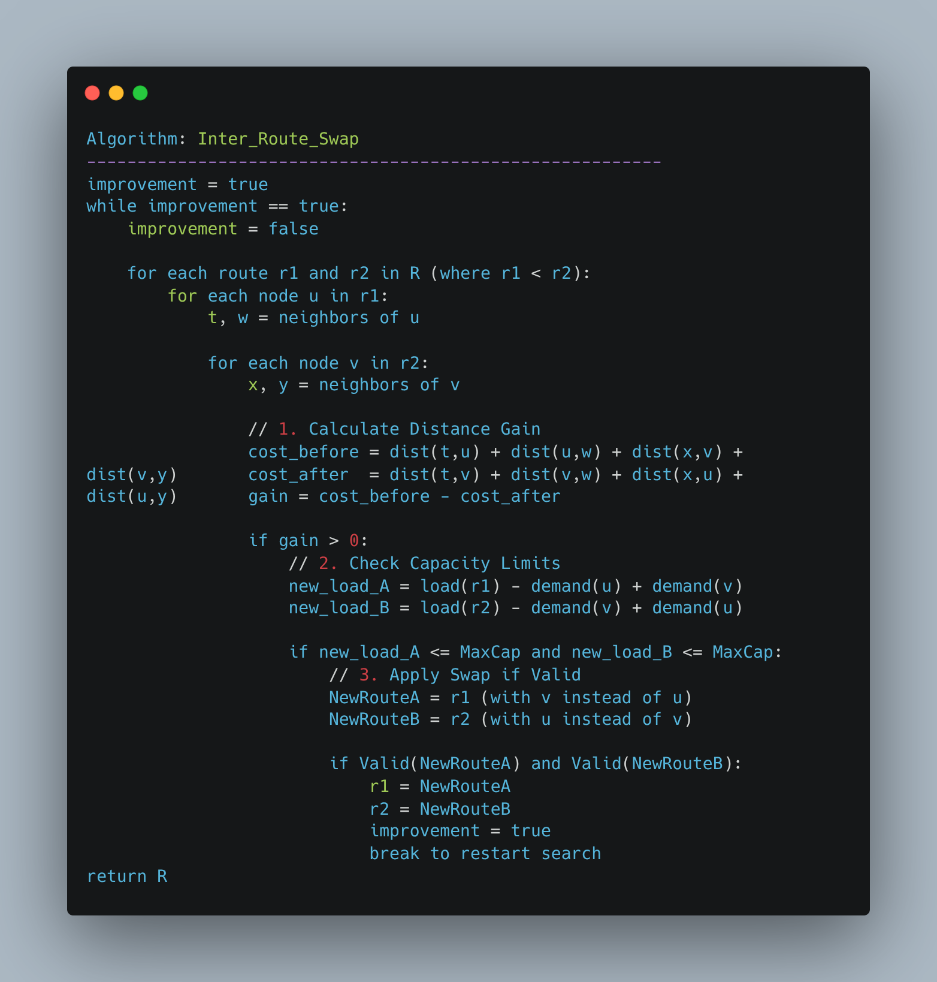
Inter Route Swap Algorithm

Slide 13
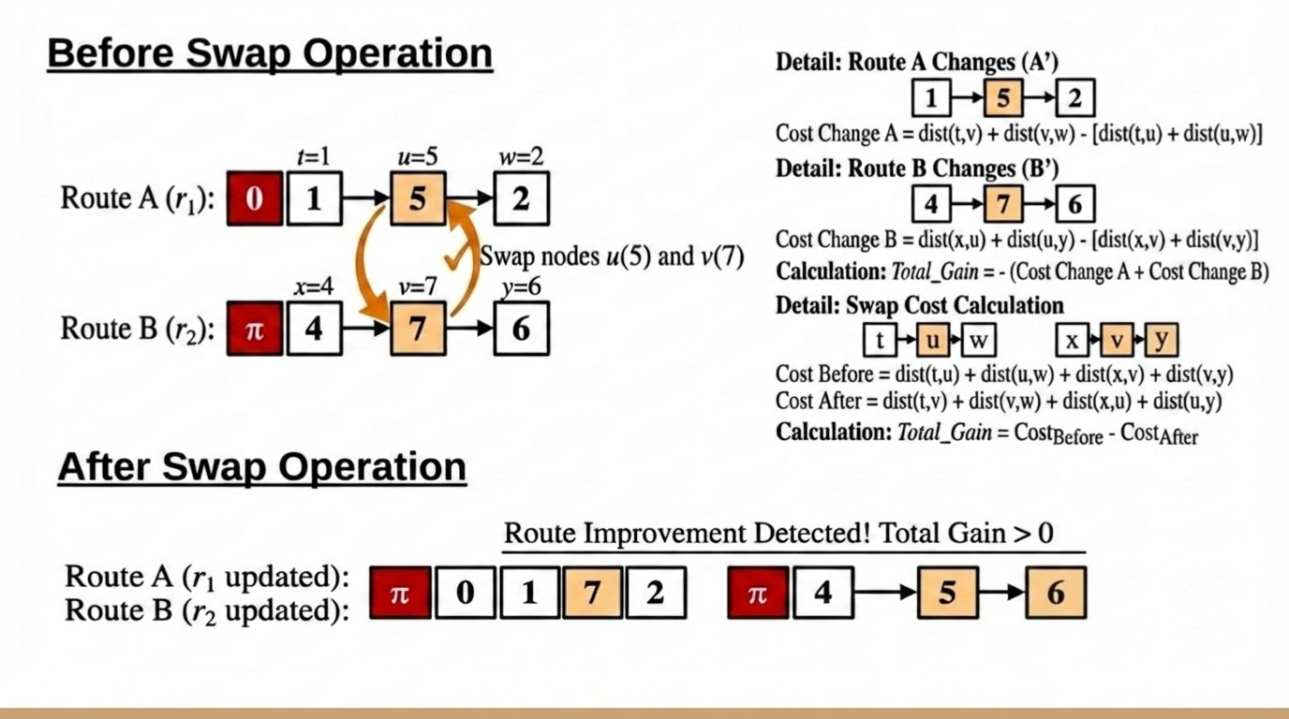

Slide 14
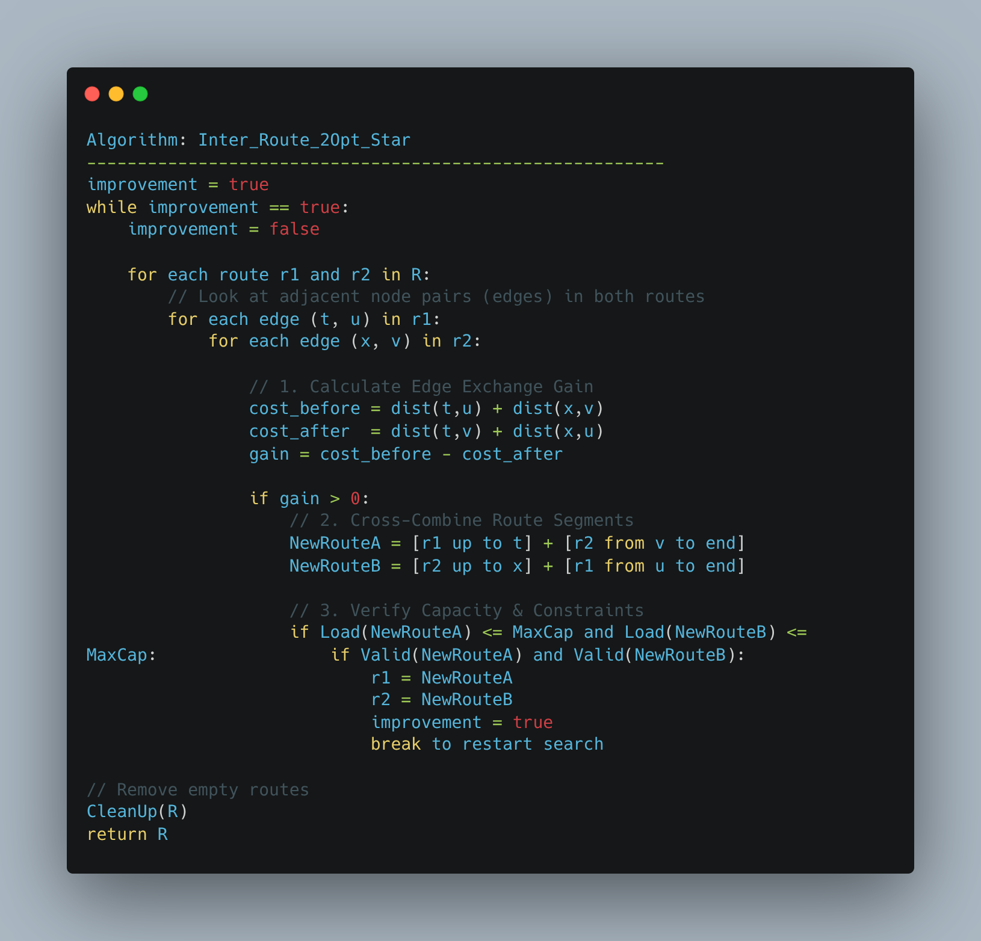
Inter Route 2- Opt Star Operation

Slide 15
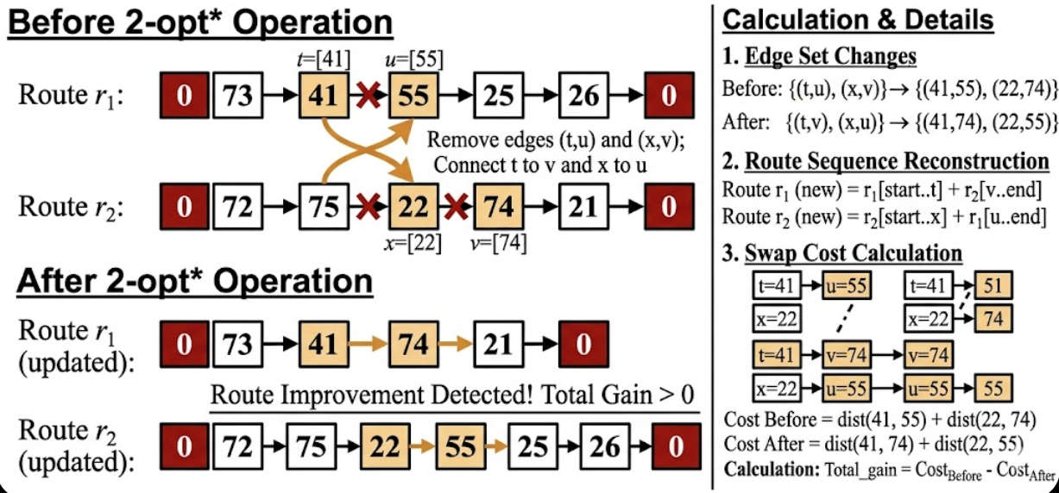

Slide 16
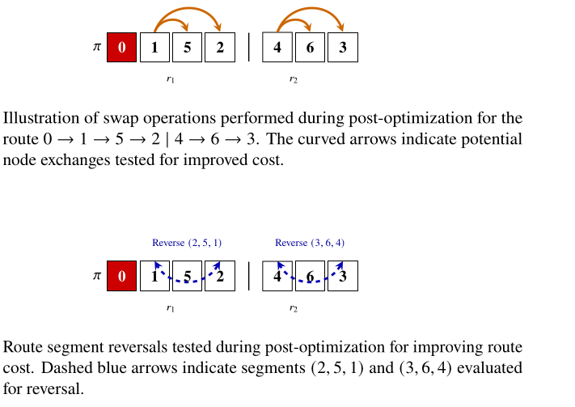
Intra Route Optimisation:

Slide 17
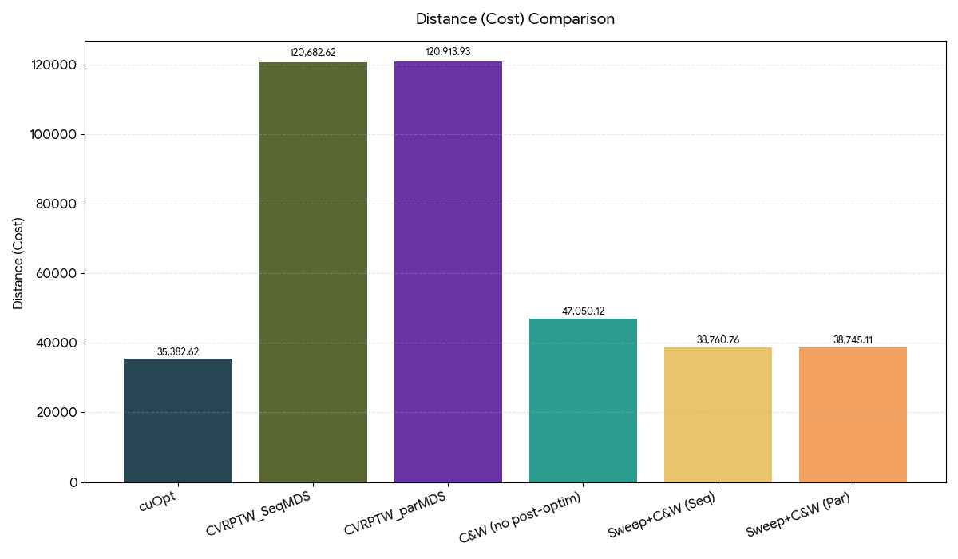
Distance Comparison

Slide 18
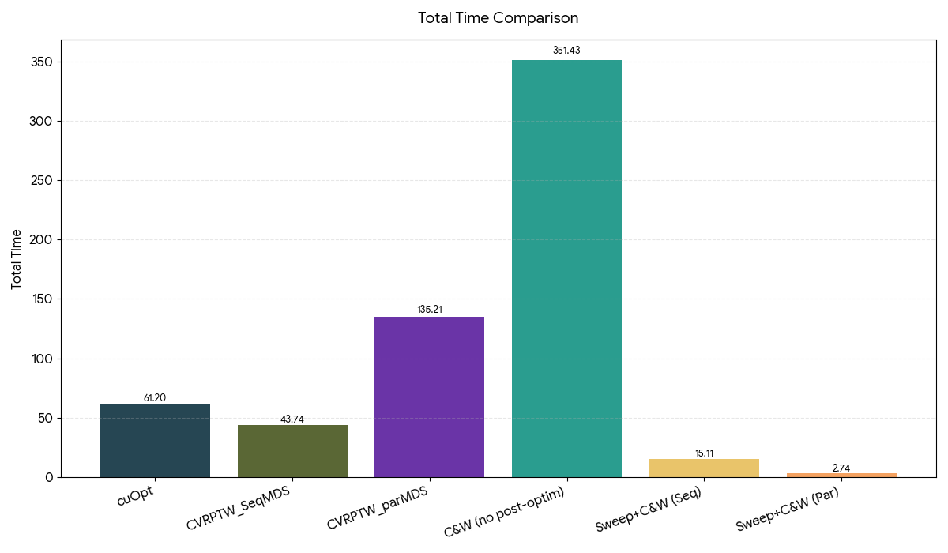
Time Comparison

Slide 19
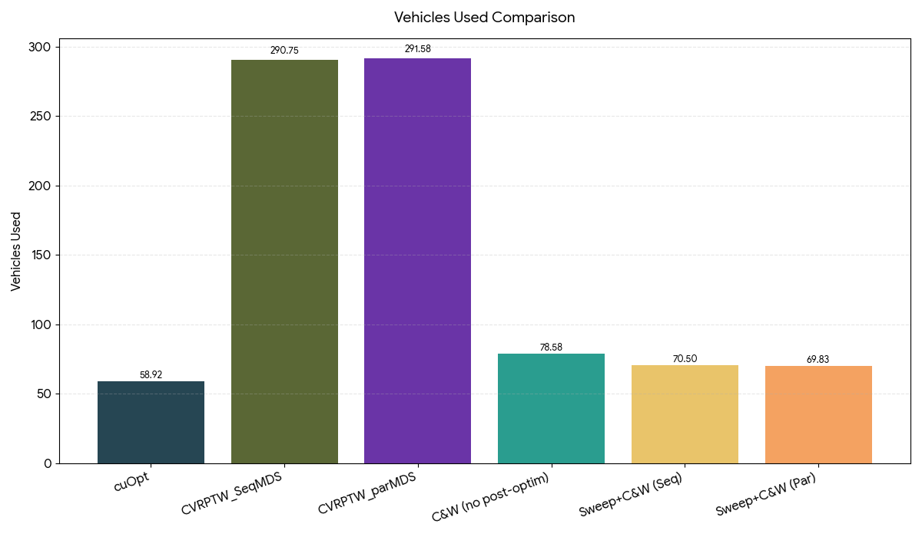
Vehicle Used Comparison

Slide 20
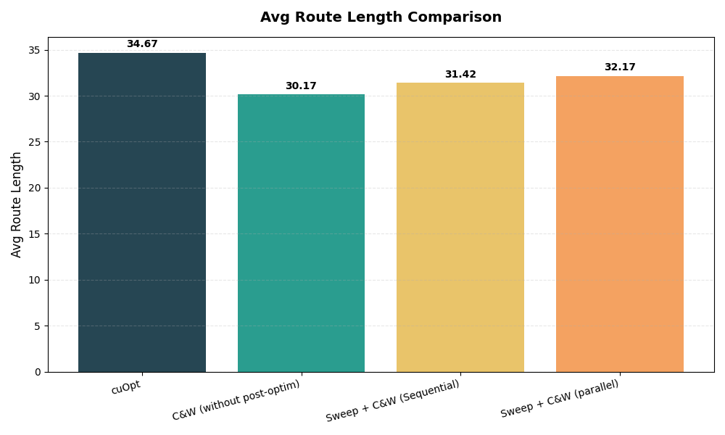
Average Route Length Comparison

Slide 21
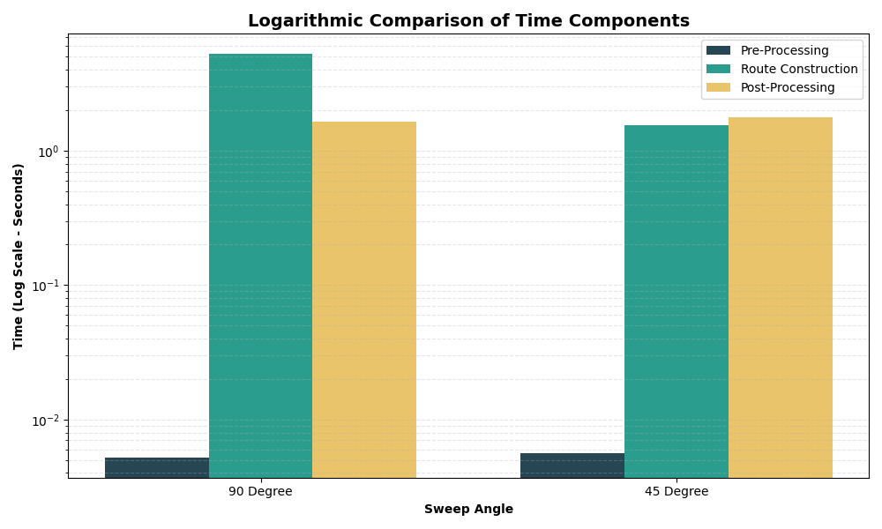
Time Comparison of CVRPTW Phases by Sweep Angle

Slide 22
